Slide 1
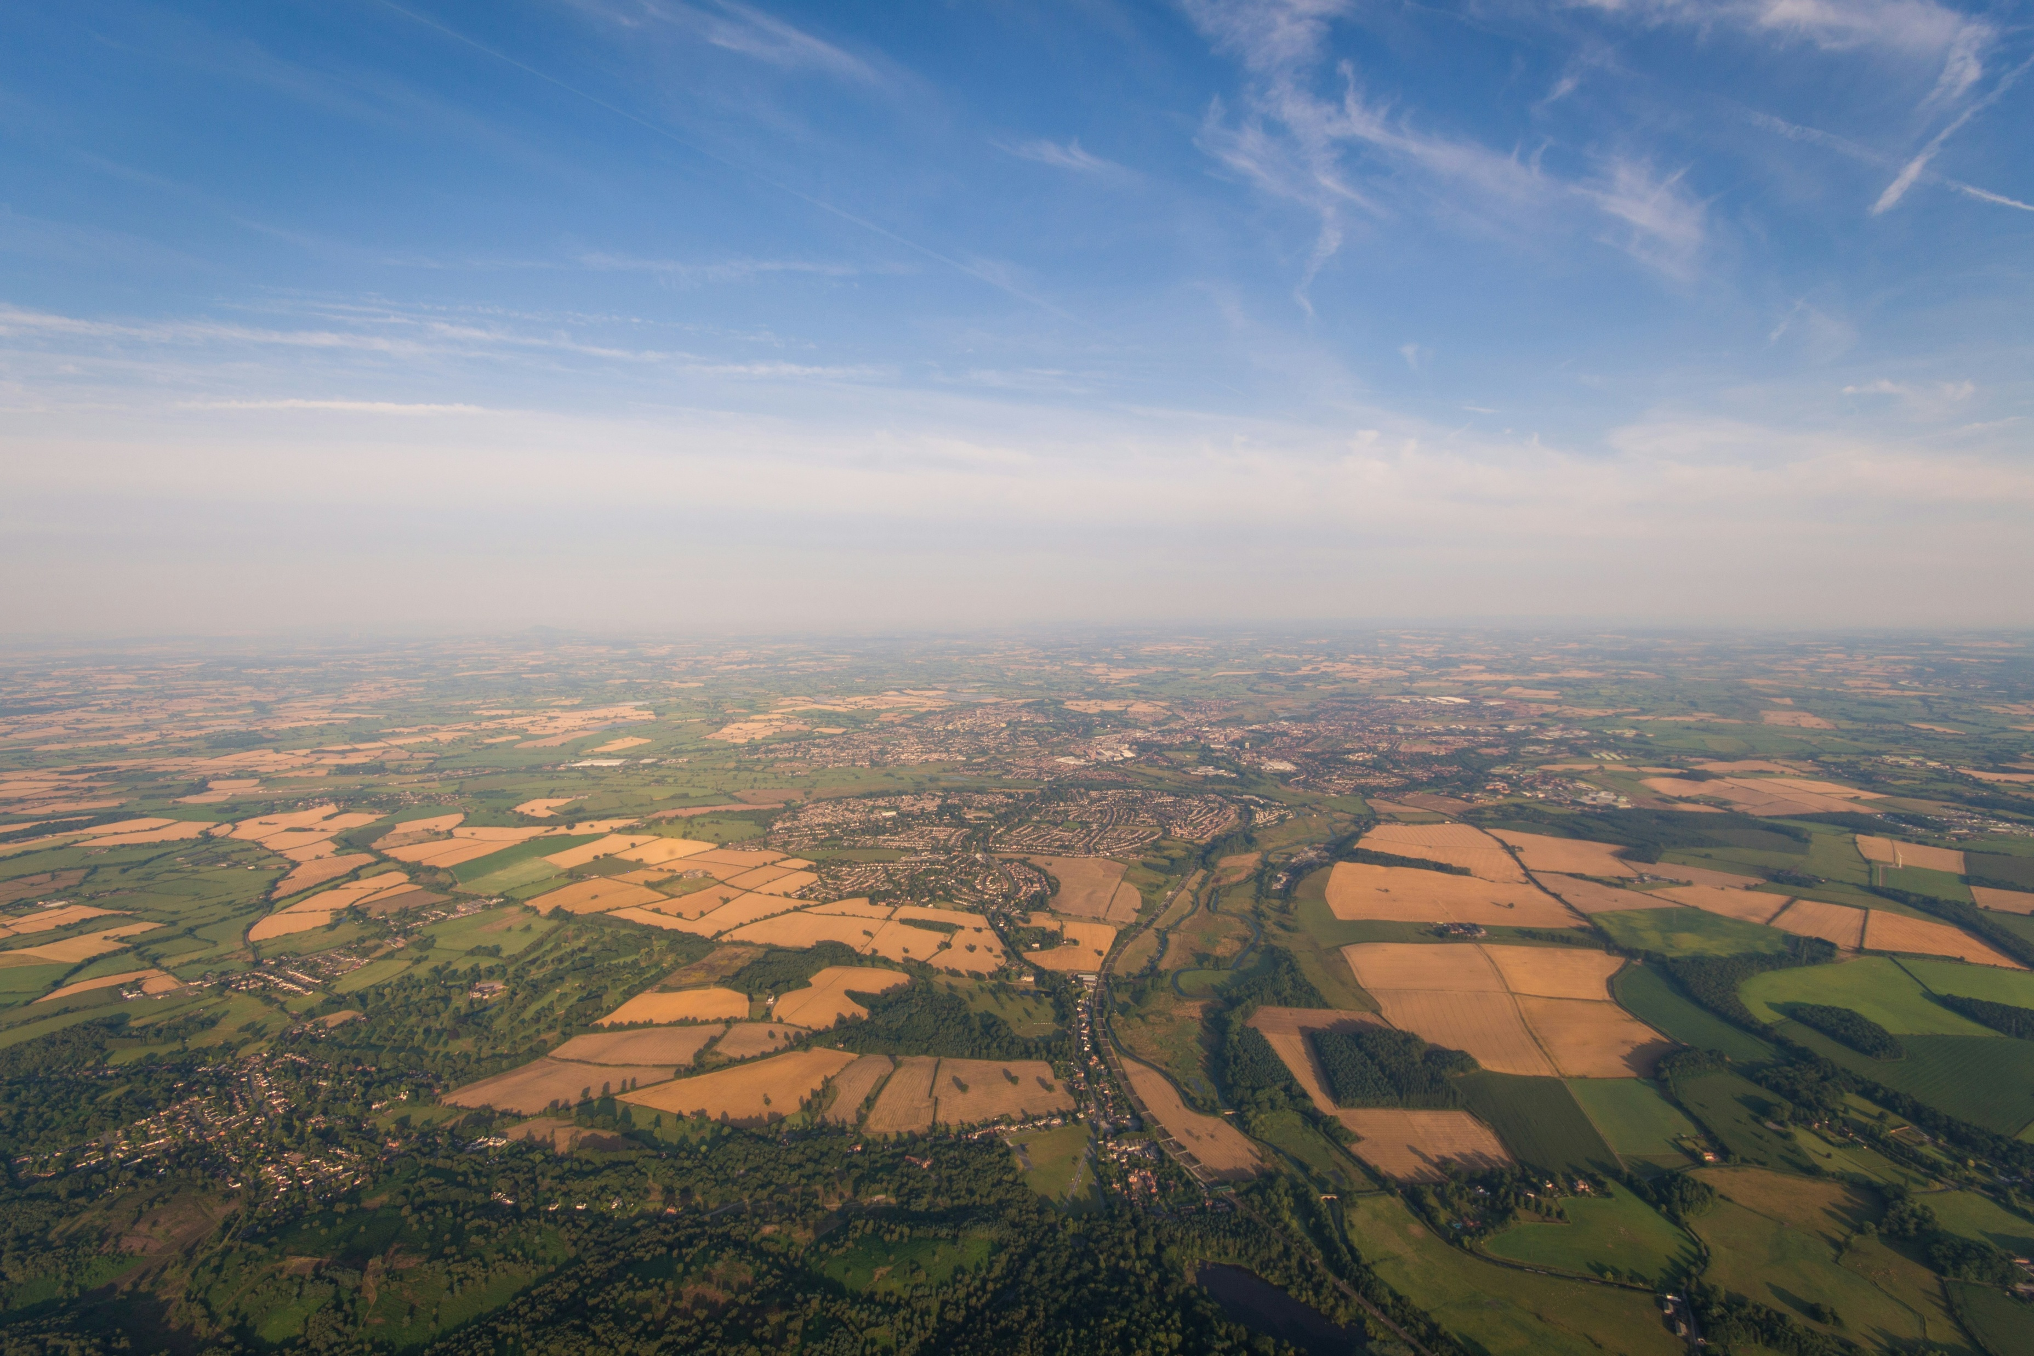

HT Booking Website WDaD 2024-25
Aaron Agoas Antal-Bento
Student ID: 23013693

Slide 2

Website Features
About page with details about horizon travels including contact information and links to resources used to create the website.
Destinations page with descriptions and pictures of all cities HT travels to and from.
Sign in/Sign up page to easily login or create an account. Includes option to stay signed in.
With error and format checking for username, email and password. Passwords are stored encrypted on database for security.
Home page with inputs to select origin, destination, passengers and date for journeys. Also includes carousels displaying destinations, travel methods with a footer at the bottom with helpful links.
Cities can be selected from a dropdown or by typing them in which filters the dropdown dynamically. Available cities to choose from are fetched from the database and dynamically update using AJAX to only show the valid cities based off the origin or destination the user has selected. User can also select ‘any origin’ and ‘any destination’ to show all journeys.
Only dates between the current date and 3 months in the future can be selected and up to 8 passengers can be chosen.
Footer includes quick links, legal information links and customer support links.

Slide 3
Website Features
Journeys page that displays all journeys in the next 7 days (after the date the user selected) to and from the cities the user selected (limited to a max of 10 journeys for performance). User can also filter the results by travel method selecting either ‘Plane’, ‘Train’ or ‘All’ journeys.
Information is displayed about the journeys such as price, times, seats available and travel method.
User can select the seat type they want for the passengers in their booking (Standard or First-class).
If there are journeys that have already departed, they are hidden in a dropdown and cannot be booked but can be viewed.
The booking checkout page is shown when the user selects a journey and provides a form to select from saved cards or to enter card details, as well as confirming all the journey details and costs.
If the user is not logged in when accessing this page, they will be redirected to login and, once they have, they will be put back to the same point in their booking.
All card details are formatted and error checked to ensure information is up to date and valid. When entering card details the user can choose to save the card for next time.
The user can also choose to upgrade or downgrade their seat type which updates the price and seat availability.
Booking confirmation page allows the user to return home, go to manage their bookings or download their ticket as a pdf. The ticket download is dynamically filled with user, journey and booking details.
The navigation bar is shown on all pages and displays links to all the other significant pages. It also dynamically resizes with screen width, so it is always easily usable.

Slide 4
User Account Features
Users can Login, logout and create an account.
Email is checked against the database to ensure the email is unique to the account.
Users can delete their account and edit their email and password.
Users can view and delete saved cards with expired cards being marked.
Users can view all account information including name, email and the date the account was created.
Users can view and manage all their bookings including:
Viewing and removing expired or cancelled tickets.
Viewing, cancelling and downloading upcoming journey tickets.
When cancelling a ticket users will receive a refund based on the number of days until their journey (25% between 80 and 90 days, 15% between 60 and 79 days and 10% between 45 and 59 days otherwise no refund will be issued).
Cancelled and removed tickets are still stored in the database so their profits and losses can be seen by the admin but are marked as cancelled or have the user ID removed. The refund amount is stored separately to the amount paid per ticket so it can be displayed in the admin reports.

Slide 5
Site Admin Features
Admins have access to all normal user account features.
They can also access an admin panel. If a standard user attempts to access any admin features, they will be rejected on the server backend and redirected to log in to another account.
On the admin panel admins can modify users account details by searching for a user (using first name, last name or email). They can then:
View and modify all users account information (including changing password and giving admin privileges).
Delete any user.
Remove user’s cards.
View, cancel, remove and modify user’s bookings.
Admins can also Add, remove or update any journey. Admins can load and view all journeys and, from there, they can remove or modify any journeys details. There is also a form to add a completely new journey which automatically appears for users to book on the home page and in admin reports.
Admins can check booking status/upcoming journey details. Here the admin can see the seat availability and revenue for all upcoming journeys with bookings, along with details about the journey. This includes the standard, first-class and cancelled seats along with the number of individual bookings by users.
Admins can also generate admin reports which are used to look at and compare stats for journeys, users, companies and bookings. This includes:
Two graphs with total number of seats sold and total revenue for each journey (with this month, year and all-time selection).
Graph to compare two journeys’ revenue over time to each other using their Journey IDs.
Table to rank and view top customers and their details including spending and booking statistics.
Compare travel method (plane and train company) statistics and earnings including a pie chart for income from both methods.

Slide 6
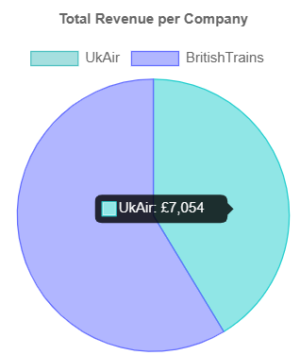
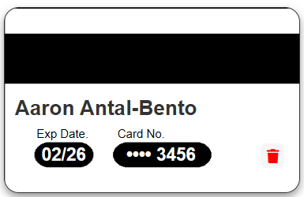
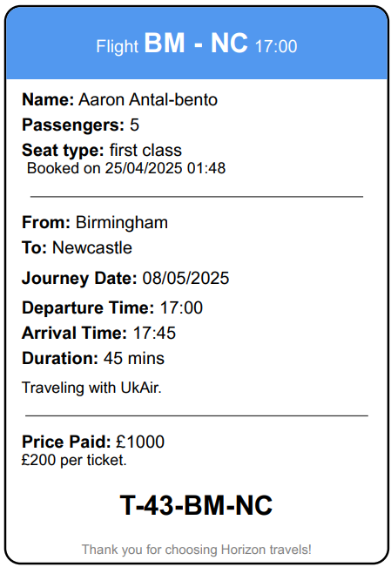
Additional features
My website allows the user to choose between two types of travel methods (plane and train). These are represented as two companies within the database with individual rules for each such as prices, seats available, journey durations, cities in network and weekdays that services run on.
Admins can also keep track of how much each travel method is selling in the admin panel.
Users can save, view and delete bank cards they have used to book journeys.
Users can download their tickets with account, journey and ticket details dynamically filled in.
Users can view multiple options for journeys to book, including upcoming journeys in the days after the date that they selected.

Slide 7
Security features
All passwords are stored in an encrypted form, and all password processing is done on the server.
Passwords must be at least 8 characters long and entered twice when creating an account to ensure to user remembers it.
When users want to change their password, they are required to enter their old password first.
Only necessary card details are shown to the user when displaying saved cards to avoid sensitive data being sent to the client unnecessarily.
Only the last 4 digits of the card number are displayed and the CVV is never displayed.
This is written into the SQL, so the full card number is never retrieved.
Expiry dates are checked against the current date to make sure that the card is in date.
Session data is stored in an encrypted form allowing sensitive data to be stored safely and ensuring it has not been modified externally.
Admins are handled on the backend and all admin functions require the account logged in to be an admin to run.
All user details and inputs are checked and formatted on the client side and the server backend including card details, account details, booking details and price details. Bookings are also checked at every point to ensure they have not departed and still have available seats.
Prices are all retrieved directly from the database and calculated on the server's backend ensuring the user cannot modify them.
All SQL statements with dynamic data or user inputs are validated and sanitised to prevent any type of SQL injection attacks. All data, column names and table names are check for malicious characters.

Slide 8
How Cookies are Used
Cookies are only used if a user accepts them (when creating an account, the terms and conditions include accepting cookies).
Cookies are used to keep track of journey selections (to, from, date and passengers) made by users that are not signed in so they can be put back to the same place in their booking when logged in.
Cookies are also used to store session data so users can stay signed in even when closing their browser (they must choose ‘remember me’ when logging in).
Session data is encrypted for security and privacy.
Session data is used to store cookie preference, signed in user details (name, user ID and privileges), booking details that are used between pages (journey ID, seats, seat type and journey date) and which page the user is being redirected from.
Session data persist indefinitely if the user selects to remember their account otherwise it will remain until the browser is closed.
When logging out or deleting an account all cookies and session data are deleted for security.

Slide 9
User Experience Features
All user's inputs are formatted and validated to make entering data easier. For example, names are auto capitalised when creating an account [‘john doe’ would be stored as ’John Doe’]. Emails are validated to ensure they are in the format [_@__.__], card numbers have a space automatically added every 4 numbers for readability [0000 1111 2222 3333] and expiry dates are checked against current dates and automatically insert a ‘/’ between numbers [00/26].
Whenever data is not accepted, descriptive error messages are given to the user including when they miss format an input, book a journey that is full or departed or use a card that has expired. All data is checked on both the client and backend to ensure integrity.
To improve quality and the user experience, ‘s‘s will be dynamically added or removed wherever singular and plural forms are used. [‘1 passenger’ and ‘2 passengers’].
The users can select to store their cards on their account when booking allowing them to easily check out next time.
The site has excellent navigation with all pages linking together through the navigation bar at the top of each page.
Sign in is quick and easy only requiring the users email and password. Users can select to remember their account allowing them to stay signed in next time they access the page from the same browser.
When selecting cities, users have the option to type or select from a dropdown that dynamically updates based on the valid cities and the user's selection for where the journey is coming from or going to.
Users can access full features of the site without logging in. And, when it comes to confirming their booking, they are redirected to sign in or register. After they have, they are returned to the same place in their booking using cookies.
If an error occurs (like a journey being departed or no user login) users will be redirected to a relevant page such as re-selecting a journey or the login page.

Slide 10
Accessibility features
Low load on user's device:
Minimal amounts of data are transferred between the server and the client reducing internet usage and allowing pages to load with a bad internet connection.
Pages are sized and optimised for smaller devices with less processing power and the processing and resizing is only done on larger devices.
More intense processing and calculations are done on the server before being sent to the user minimising load on user's devices and making use of servers higher processing power.
Faster loading:
When multiple SQL queries need to be run, they are strung together minimising the number of times a connection needs to be opened to the database.
Visibility and site navigation:
Contrasting colours and easy to navigate pages are used to allow as many users as possible to access the site.
The site is user friendly and well labelled allowing anyone to access it with ease.
Things to improve:
Only load images when they come on screen to improve graphics and internet load.
Render images in a lower resolution on smaller screen sizes to improve speed and efficiency.

Slide 11
Legal and ethical
Cookies:
By default, cookies are not accepted. When the user enters the home page, if a cookie preference has not been selected, a pop up will appear prompting the user to accept or reject cookies.
When the user creates an account, they are told that creating an account means they accept the terms and conditions. This includes allowing Horizon Travels to store the user's data and actions on the website and automatically accepting cookies as they are needed for session data to be stored.
Terms and conditions:
Although there is no actual document with terms and conditions it is simulated though links in the footer of the home page and when creating an account.
The terms and conditions for horizon travels allow the website to collect and store user information and allows the website to track their actions using cookies including storing details in session data.
Privacy:
Users' privacy is a big part of Horizon Travels through the use of good security on both client and server-side user's sensitive data is kept safe.
Image licencing:
All images and icons are copyright free and are appropriately licensed and linked in the about page.

Slide 12
Social and professional
Good accessibility:
The website can be navigated using a keyboard ensuring wider accessibility.
The website is clear and easy to navigate allowing users who are elderly or not good with technology to use the site easily.
Text colours are on a contrasting background, allowing better visibility for the visually impaired or colour blind.
Alt text and aria-labels are used, allowing impaired users to use and book with the site.
When searching for available journeys a maximum cap is set to stop too many journeys being loaded and straining users' devices.
Responsible use of user's data:
User data is only used to improve the site and keep track of earnings and is never distributed or sold.
Customer support:
There are links to customer support and help centres in multiple places to ensure users get the best experience when booking or encountering errors.

Slide 13
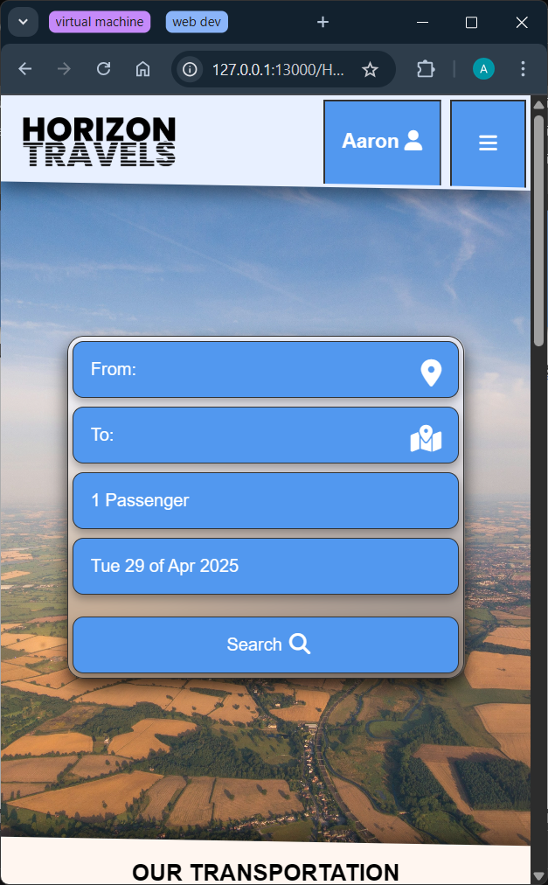
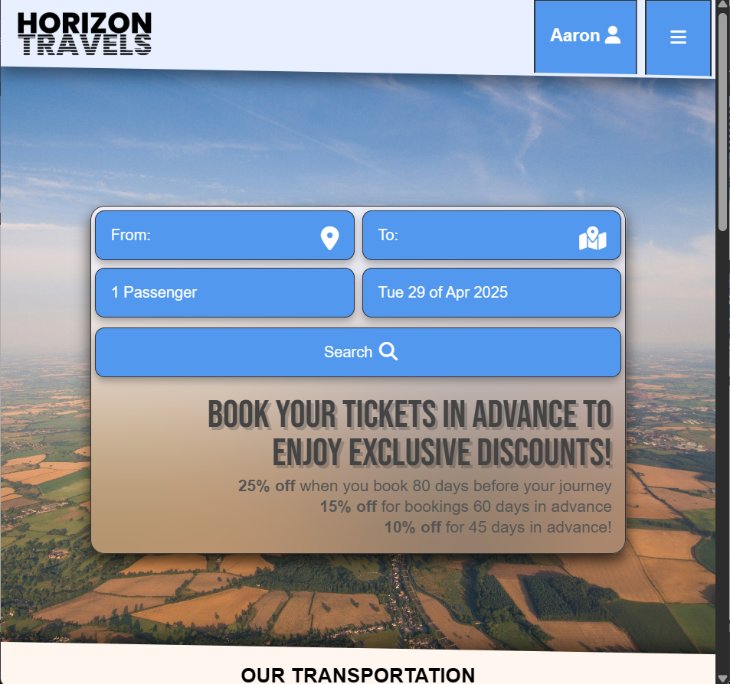
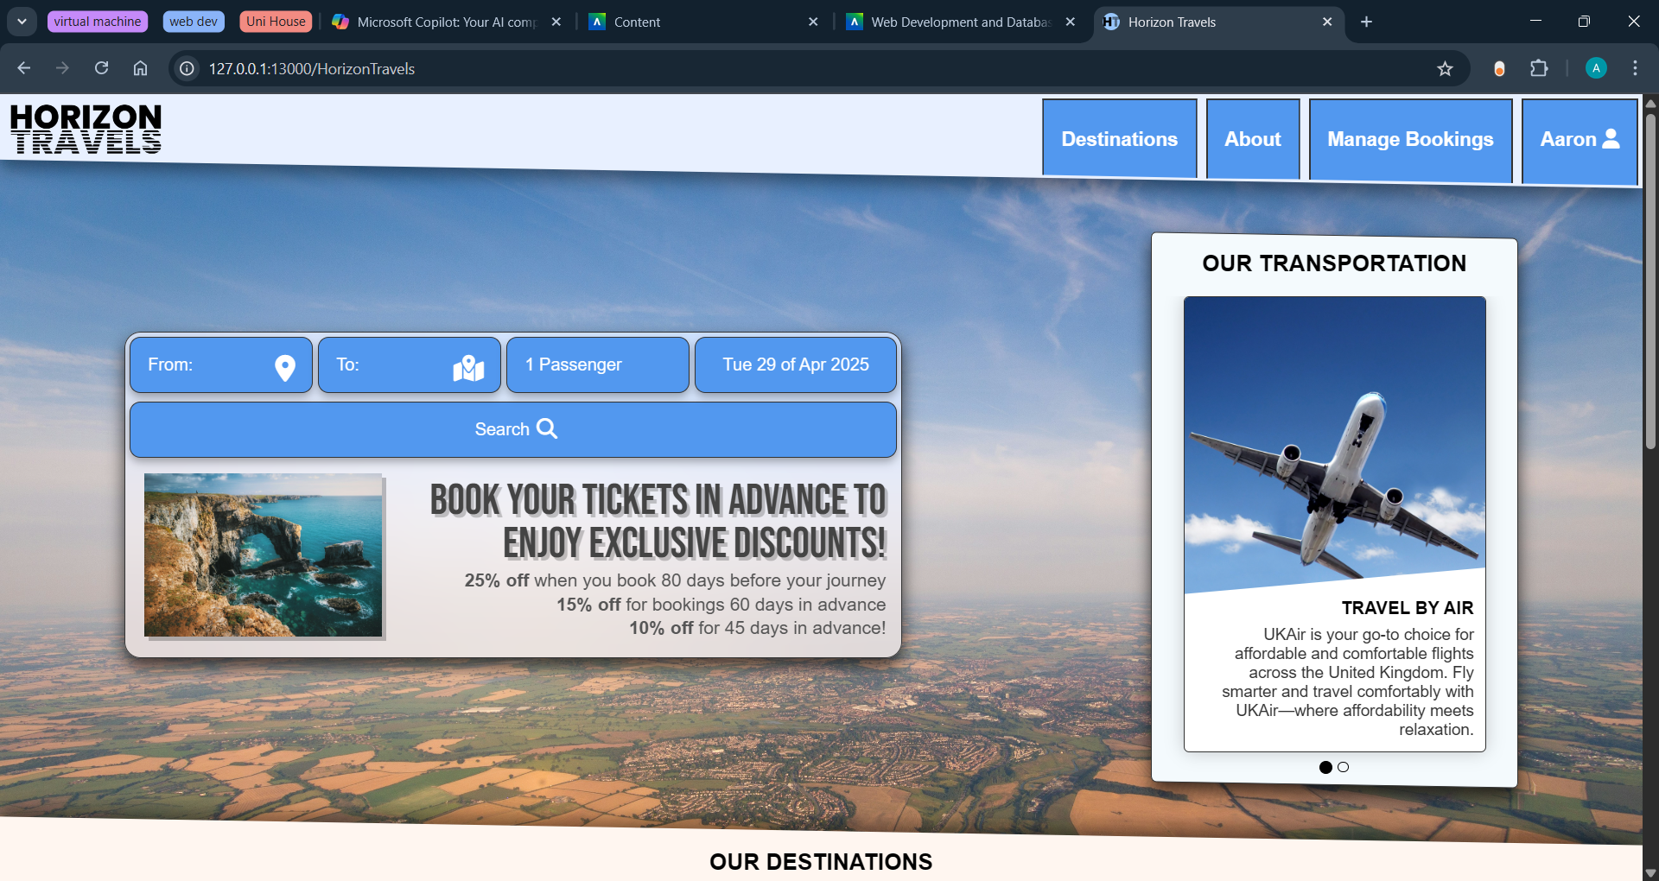
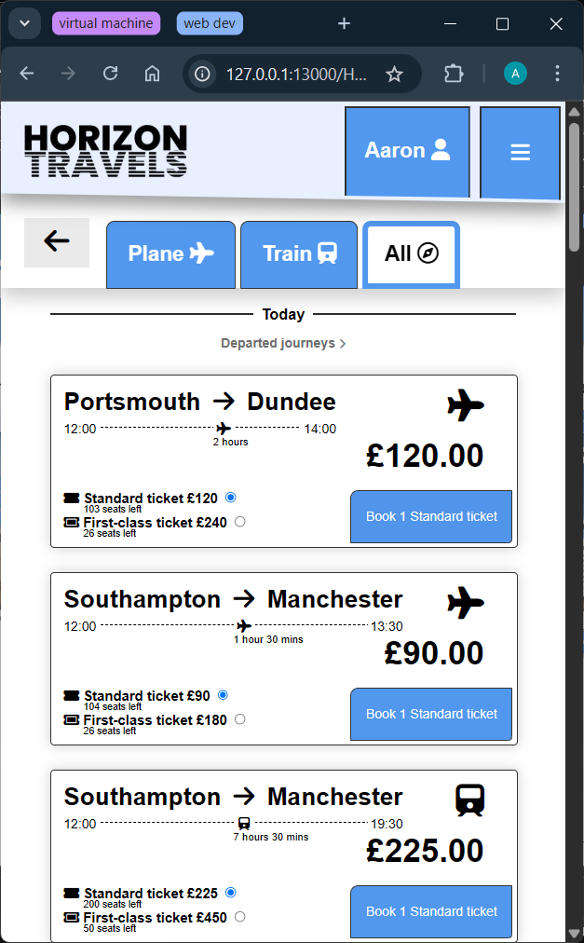
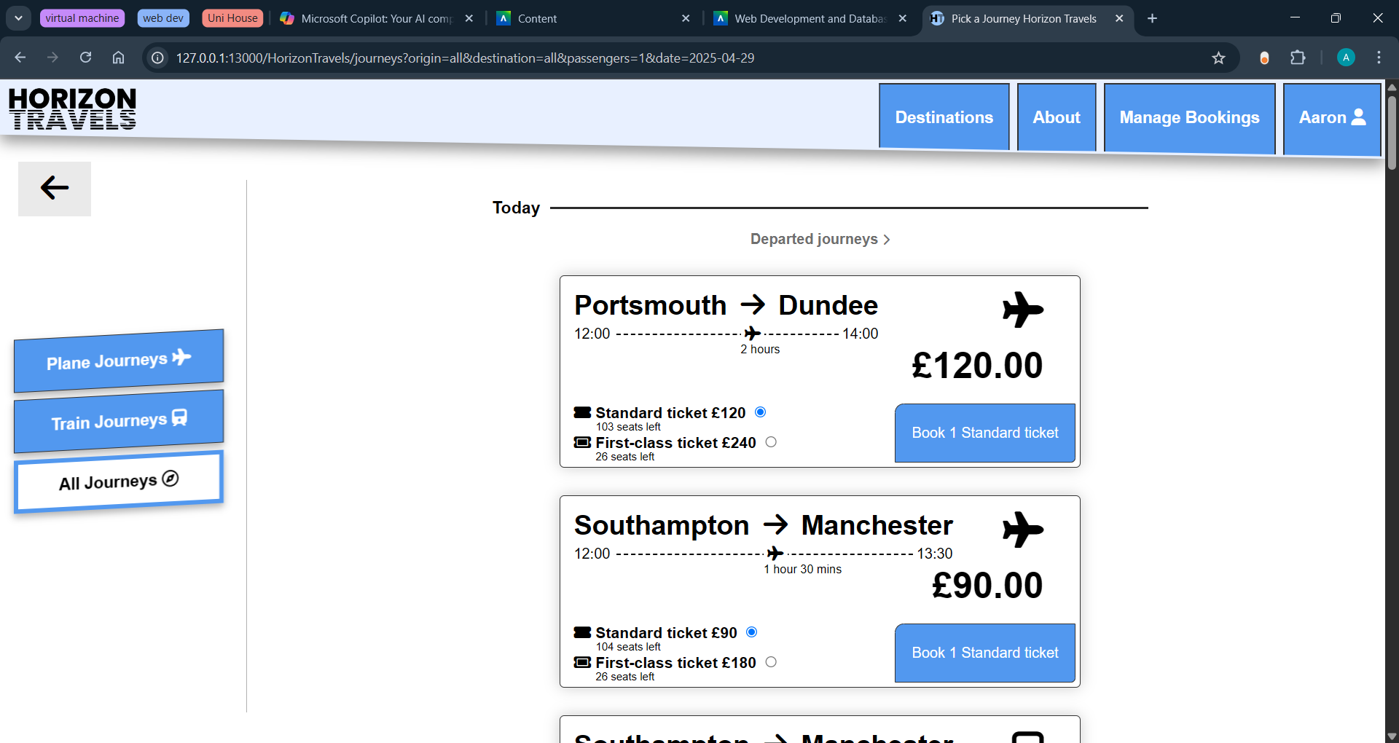
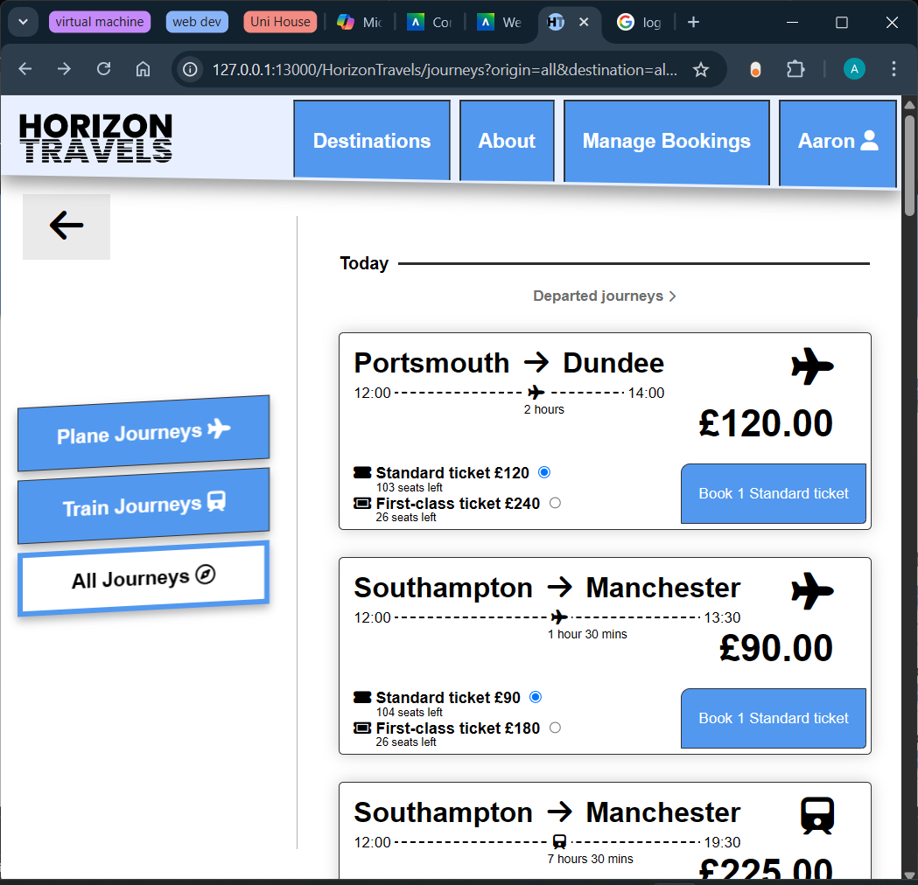
Responsive Website Design
All webpages display clearly and are visible on all screen sizes (from 485px to 1600px) and rearrange to be user friendly for at least 3 screen sizes. Below are some examples of how different pages resize to accommodate the user's device.
Small screens
Medium screens
Large screens
Home page:
Journeys page:

Slide 14
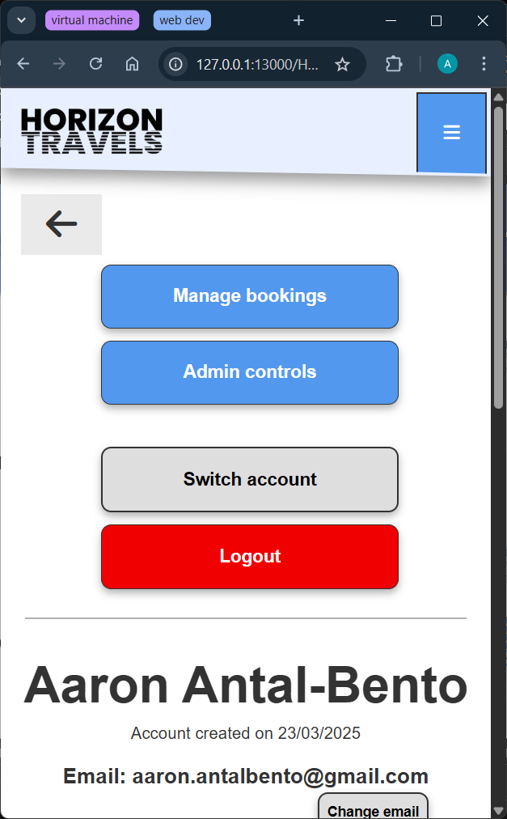
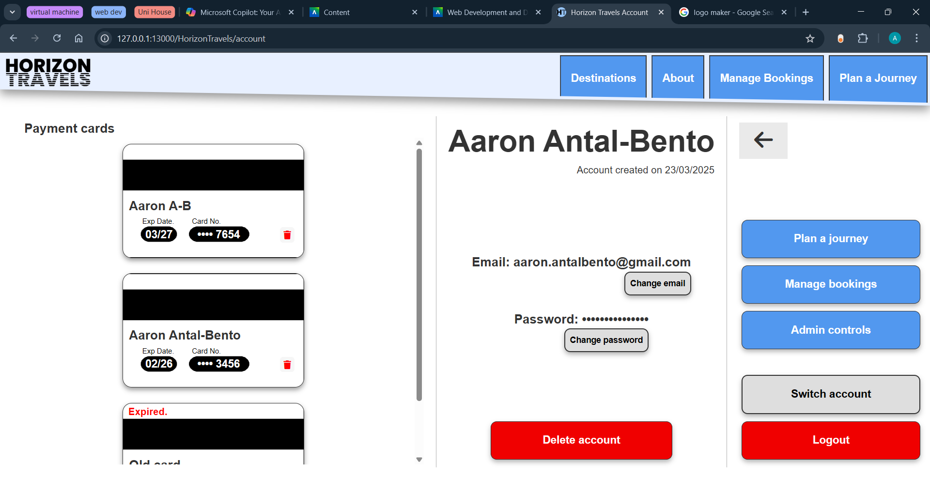
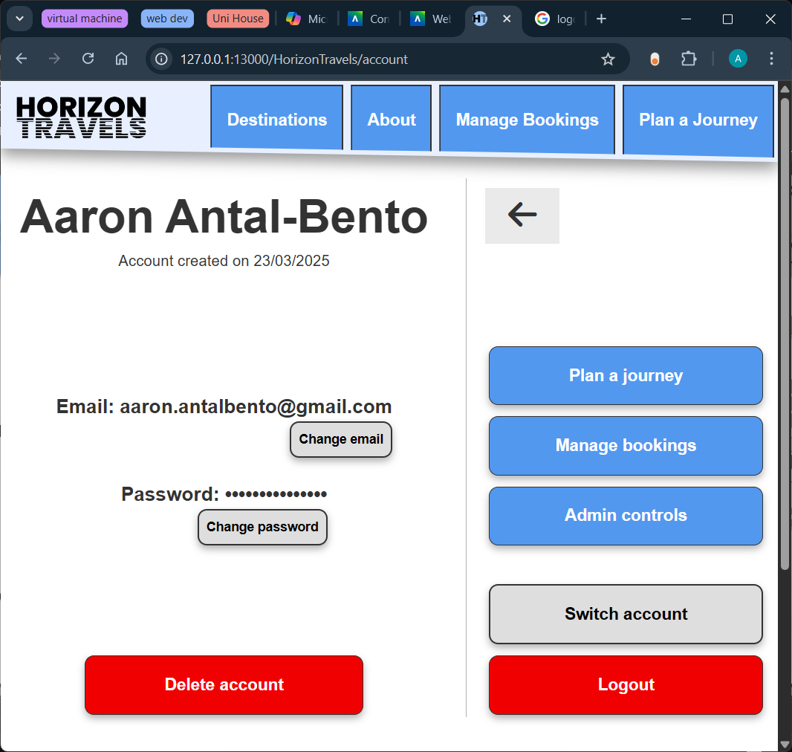
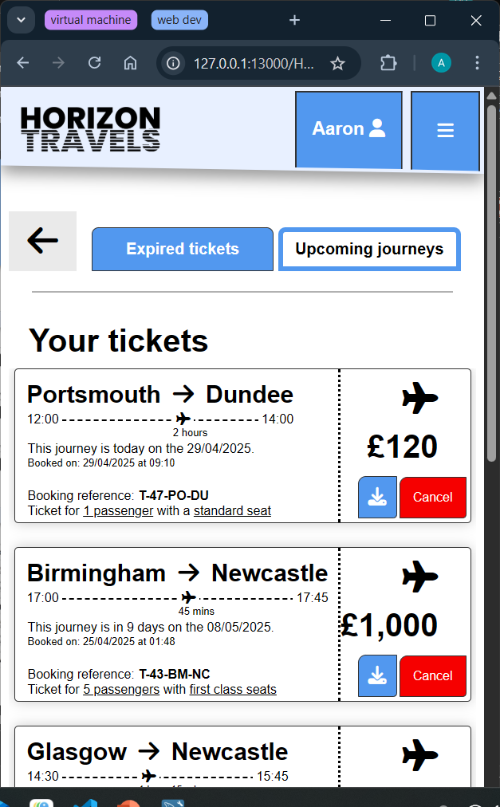
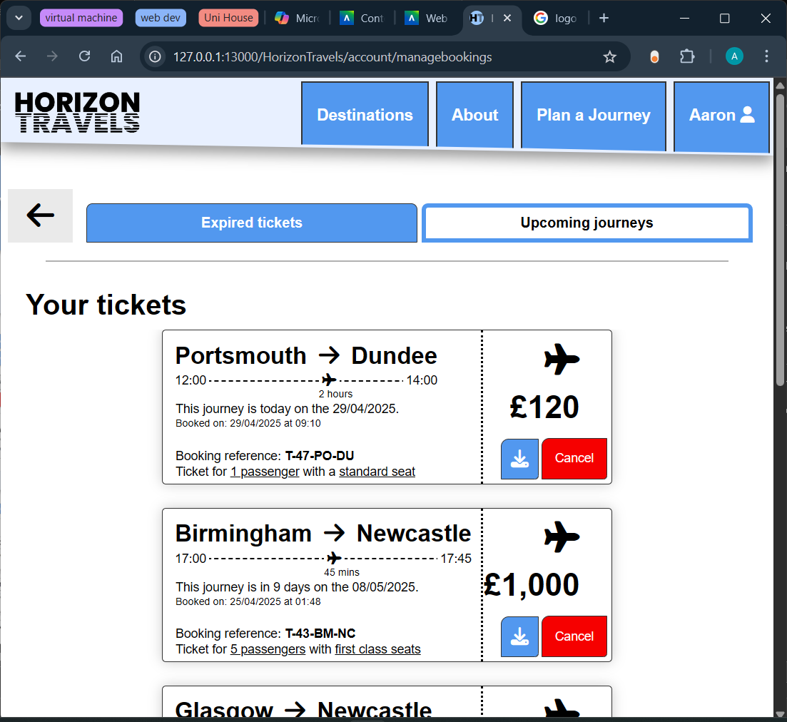
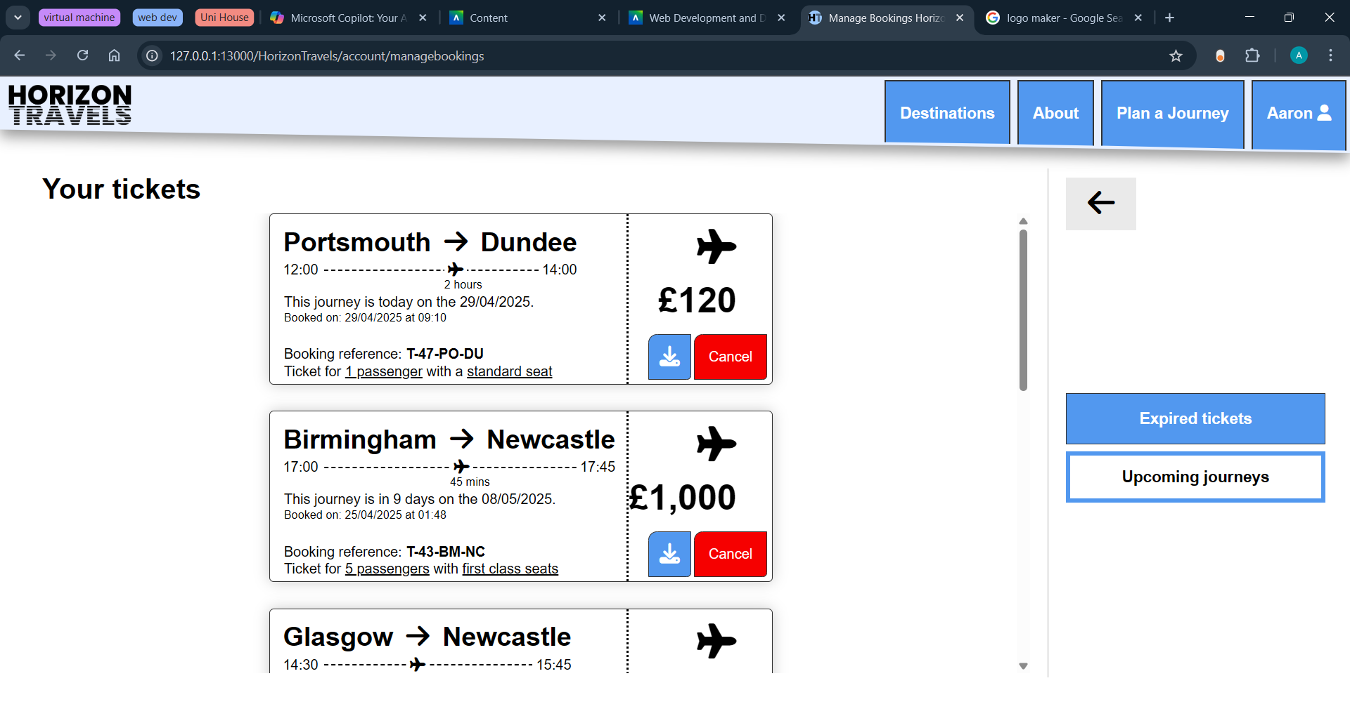
Responsive Website Design
Small screens
Medium screens
Large screens
Account page:
Manage bookings page:

Slide 15
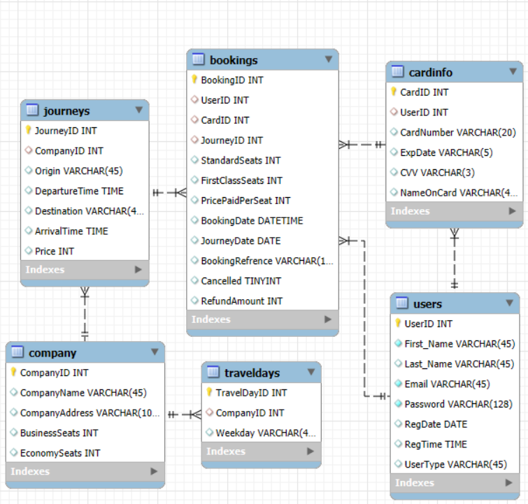
Database Design
My database is in 3rd normal form and is designed to be as efficient as possible while minimising redundancy. Redundancy in tables may cause insertion, deletion, and update anomalies. Below is a description of the function of each of the tables in my database:
Bookings table stores information about bookings that have been made by the user, including the number of standard and first-class seats in each booking, the date the journey leaves on, if the journey has been cancelled and how much was refunded for a cancellation. If a user removes the booking or if the users account is deleted the user ID is removed. These fields can be used to calculate data about which routes are selling well (used in the admin panel).
Journeys table stores data about all the journeys that run on the Horizon Travels website including times, cities, prices and the company (travel method) the journey is running with.
Users table stores information about accounts created, including users' names, emails and passwords. It also includes the type of user (standard or admin) which allows different privileges on the website.
Cardinfo table holds card details of cards that have been used to make bookings. Each card is linked to a user but if the user deletes the card from their account or their account is deleted the users ID is removed from the card table.
Company table stores company (plane or train) specific information such as the maximum capacity of standard and first-class seats on journeys running with that company.
Traveldays table is used to specify the days on which specific company's services run on. It is used with the journeys table to determine if a journey should run.

Slide 16
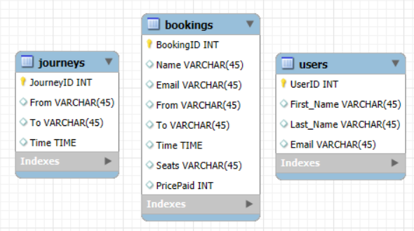
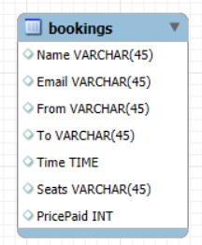
Database Normalisation
Using a simplified version of my database (for readability) I will show how I converted my unnormalized data through 1st, 2nd and 3rd normal forms:
Unnormalized data: Converting to 1st Normal form:
Here is my unnormalized example data that I want in my database. It has a lot of redundant and repeating groups which can cause errors when modifying the database. For example, for each booking a user has, their name and email is repeated. This makes it hard for the user to modify their email as their it would have to be modified for every booking the user has. It is also an inefficient use of storage as user and journey data is repeated for each booking.
To convert to 1st NF, we need all tables to have a primary key, along with each column only containing a single data entry, as well as no repeating columns within each table. I have done this by splitting the data into 3 tables with unique primary keys and splitting name into first and last name.
This is my entity relationship (ER) diagram which displays the tables and their columns in a database along with the columns, datatypes and relationships with other tables.

Slide 17
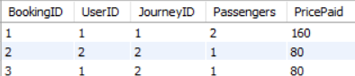
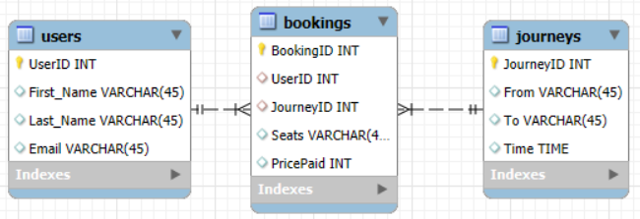
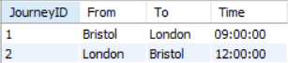
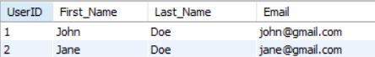
Database Normalisation
Converting from 1st to 2nd Normal form:
Although 1st normal form is a good step there is still repeated data between tables. To remove this, the primary keys (UserID, BookingID, JourneyID) should be used instead of repeating data. This allows data to be easily modified across the whole database and minimises the storage needed for the data. This ensures that all non-key attributes are fully functionally dependent on the primary key and makes sure every attribute relates directly to a single primary key.
Bookings table:
ER Diagram of data in 2nd NF
Journeys table:
Users table:

Slide 18
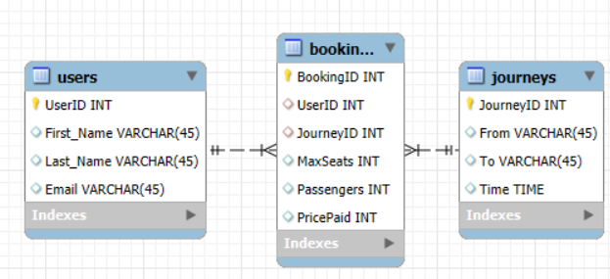
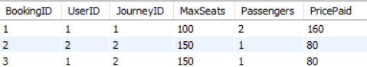
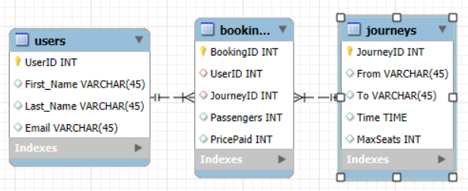
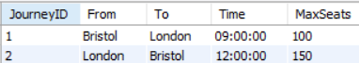
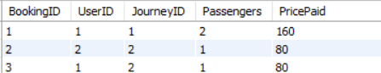
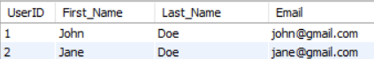
Database Normalisation
Data in 2nd NF with MaxSeats column added:
Converting from 2nd to 3rd Normal form:
3rd normal form ensures that all non-key attributes in a table depend only on the primary key. Here I have added max seats to the 2nd normal form database to demonstrate that max seats is dependant on journey ID.
ER Diagram of data in 3rd NF:
To convert the database from 2nd to 3rd normal form I moved MaxSeats to the journeys table making it fully dependant on the primary key and minimising the chance of redundant fields. Now my database is better optimized for efficiency and data integrity.
Bookings table:
Journeys table:
Users table:

Slide 19
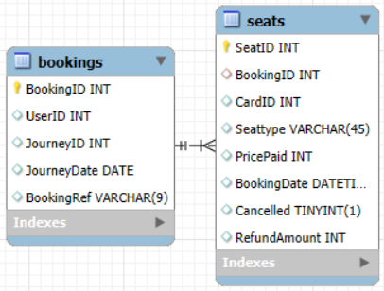
Things to Improve
Currently the seats a user booked in a single booking are stored in the columns ‘StandardSeats’ and ‘FirstClassSeats’ this limits the user to only being able to book seats of the same class (and price) and means that editing bookings, such as adding and removing seats, is not possible due to the price discount for early bookings.
To fix this a new ‘seats’ table could be created with the columns SeatID, BookingID, Seattype, PricePaid, Cancelled and RefundAmount.
A useful feature to add would be allowing the user to edit the date of the journey as well as changing the departure time if the journey runs multiple times a day.
An improvement could be removing many of the hard coded features of the backend such as price multipliers for first class seats, early bookings and cancellation charges. Many values associated with company data could also be made more dynamic.
A good feature to implement in the future would be allowing admins to add, modify and remove companies, allowing Horizon Travels to provide more than two travel methods.
Example of what the modified tables in the database would look like if a ‘seats’ table was added.

